Slide 1
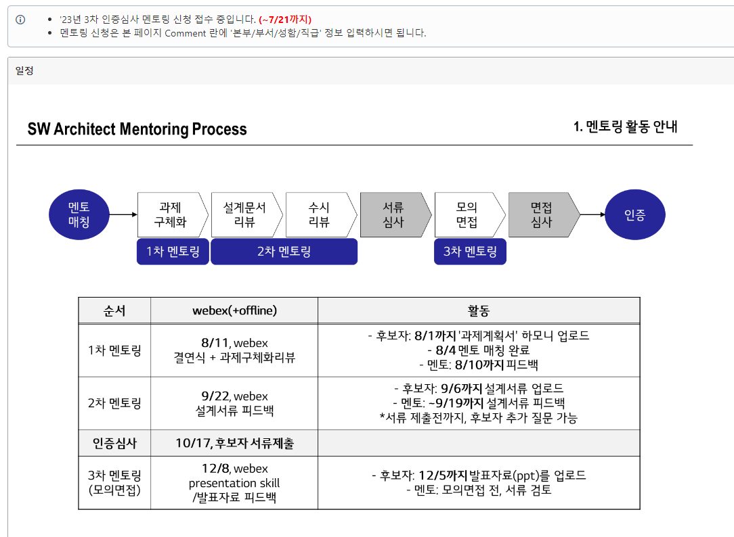
2023 3rd certification screening mentoring application is being accepted (Until ~7/21)
To apply for mentoring, simply enter “headquarters/department/name/position information” in the Comment section of this page.
Guide for mentoring activity
Mentor
matching
Materialize
The task
Design
Document
Review
Non-schedule
Review
Document examination
Mock interview
Test interview
Verification
1st mentoring
2nd mentoring
3rd mentoring
Sequence
Activity
Candidate: Upload "Task Plan" Harmony by 8/1
8/4 Mentor Matching Completed
Mentor: Feedback by 8/10
1st mentoring
Alliance ceremony + Task materialize review
Candidate: Upload design documents by 9/6Mentor: Feedback on design documents until September 19
* Candidates can ask additional questions before submitting documents
2nd mentoring
Feedback on design documents
Certification screening
10/17 Candidate submitting document
3rd mentoring
(Mock interview)
Candidate: Upload presentation materials (ppt) by December 5
Mentor: Before the mock interview, review the documents
Feedback on presentation document

